Slide 1

Recipes You’ll Love, Before You Know It.
By Rohan Arcot

Slide 2
Predictive Tasks - User Ratings
Recommendation System Task: Predict explicit user ratings for recipes
Model: SideFeat-AttAE: an Information-Aware attention based autoencoder hybrid recommender system
Learns user embeddings
Learns item embeddings
Uses Recipe features (minutes, #steps, #ingredients, nutrition, tags)
Evaluation Metrics: MSE on train -> validation -> test splits
Strong Baseline: Matrix Factorization (SVD)
Review-Based NLP Task: Predict user’s rating from the written review text
Fine-tuned DeBERTa-v3 regression model
Captures subtle, contextual sentiment in reviews
Maps text -> continuous rating score
Evaluation: MSE on train->validation->test splits
Strong Baseline: TF-IDF + Ridge Regression

Slide 3
Dataset + Prior Work
This dataset was scraped from Food.com
Consists of 230K+ recipes and 1M+ user interactions (reviews) covering 18 years. (2000-2018).
Recipes kept if >= 3 steps and 4-20 ingredients
Users kept if >= 4 reviews
After filtering -> 180K+ recipes and 700k+ reviews
Original use is to support personalized recipe generation and recommendation
Given a recipe name + partial ingredients + user history, generate a full recipe that matches the user’s tastes.
“Generating Personalized Recipes from Historical User Preferences” Majumder, Li, Ni, McAuley — EMNLP/IJCNLP 2019
Techniques: GRU encoder-decoder with three personalized attention modules: prior recipe attention, prior technique attention, and prior name attention to learn what the user likes based on previous recipes.
Results: Personalized models beat all baselines in perplexity, coherence, personalization accuracy, and human preference. Human evaluators prefer personalized recipes 63% of the time
Conclusion: Personalization is key. User-aware attention leads to more plausible, coherent, and customized recipes.

Slide 4
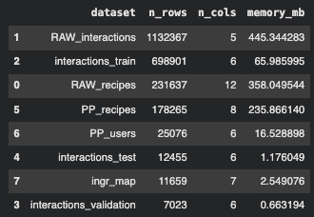
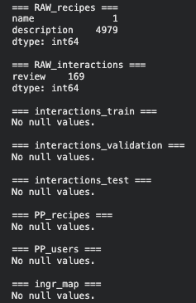
Raw Data
RAW_recipes.csv: list of all recipes with metadata including ingredients, steps, nutrition facts, tags, and timestamps
RAW_interactions.csv: All user-recipe interactions containing ratings, reviews, and review dates
Interaction Split Files
interactions_train/validation/test csv: user-recipe interactions with remapped indices for modeling
Preprocessed Data:
PP_recipes.csv: tokenized and structured recipe features including name tokens, step tokens, ingredients IDs, techniques, and calorie level
PP_users.csv: User-level behavioral features including technique preferences, items rated, and corresponding rating histories
Ingredient Mapping
Ingr_map.pkl: mapping from raw ingredient text to canonical ingredient IDs and standardized forms
Datasets

Slide 5
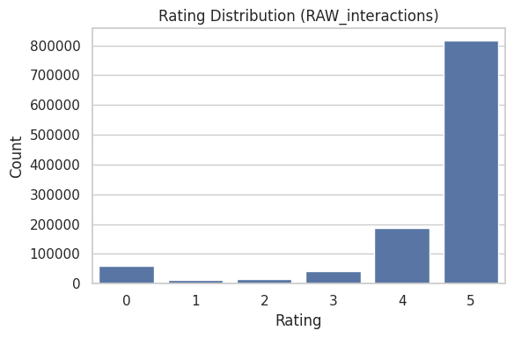
Rating distribution shows strong positive bias.
Reviews cluster around 4-5 stars and substantial neutral reviews (0 stars).

Slide 6
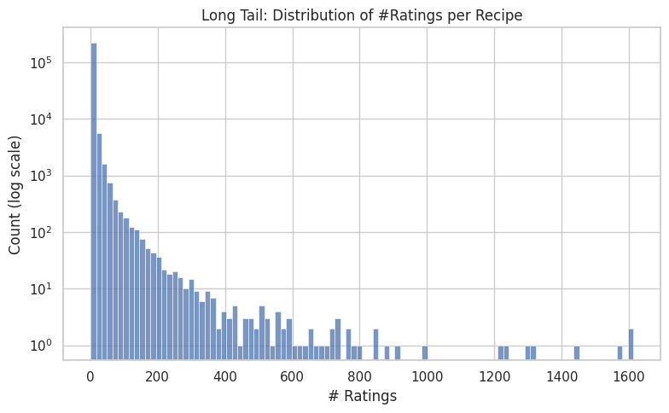
Most recipes receive very few ratings
Follows a heavy-tailed distribution

Slide 7
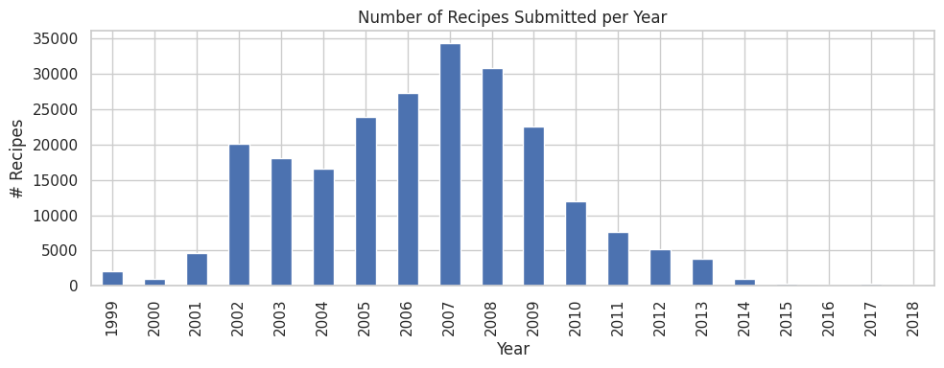
Recipe submissions surged from 2002 to 2009, peaking in 2007. Creates temporal imbalances influencing interaction density and popularity.

Slide 8
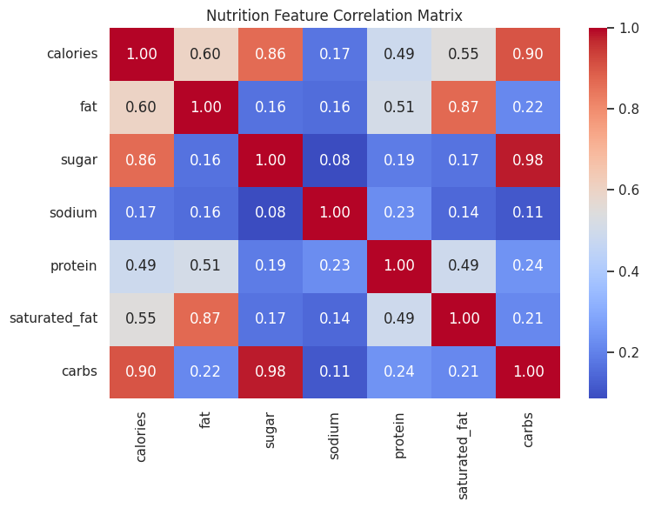
Nutrition attributes reveal strong correlations.
Calories correlate heavily with carbs and sugar, while sodium is mostly independent.

Slide 9
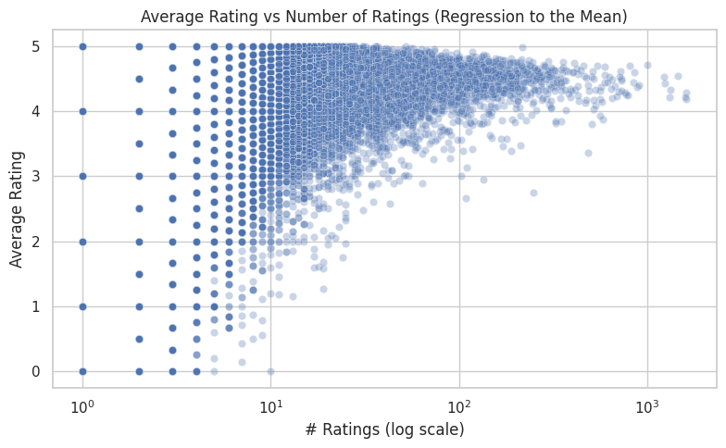
Recipes with few ratings have extreme and unstable averages. Popular recipes regress toward a stable mean

Slide 10
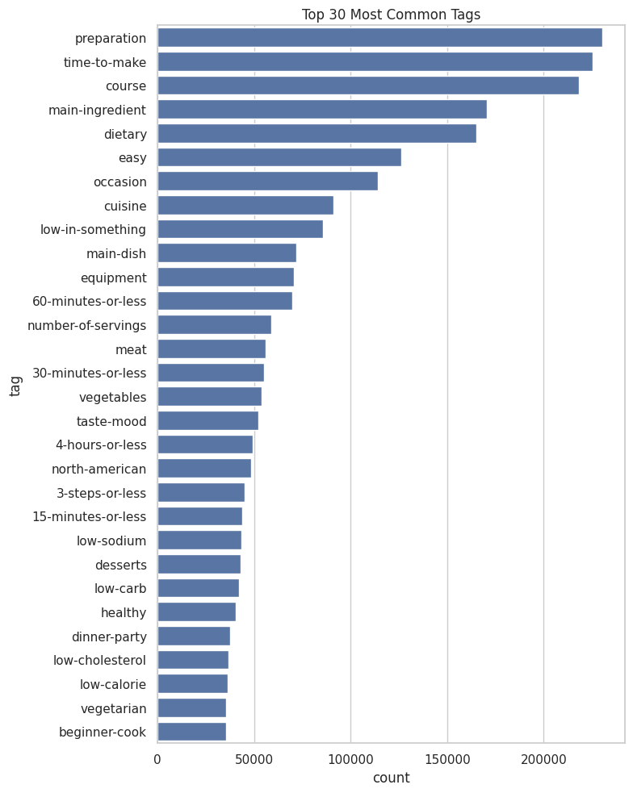
Most frequent tags reveal recipe organization structure.
Dominant themes like preparation style, time-to-make, dietary categories, cuisine.

Slide 11
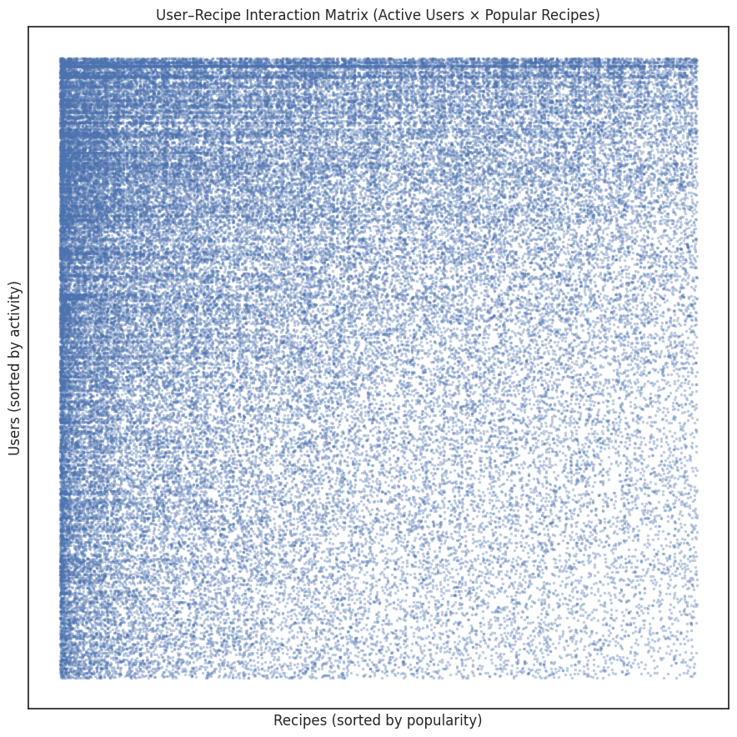
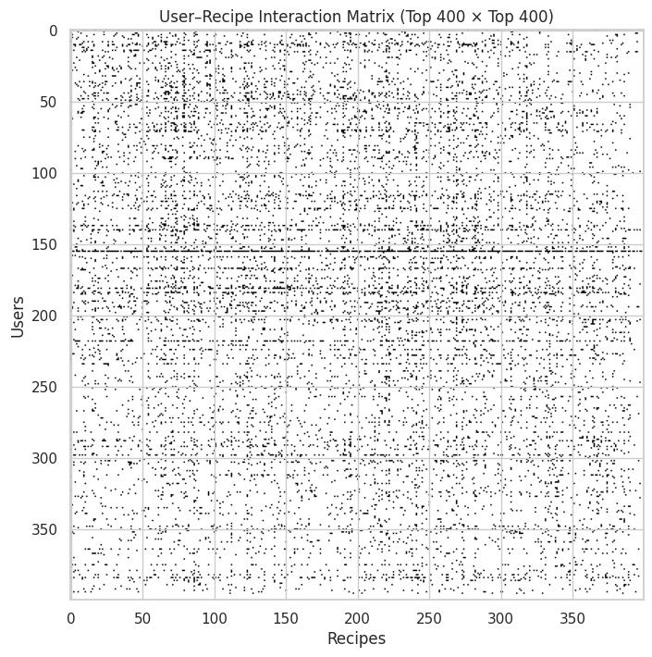
Active users x recipes (sorted) - 2000x2000
Reveals structured sparsity and long-tail behavior
Random active subset - 400x400
Shows extreme sparsity

Slide 12
Recommendation System Task: SideFeat-AttAE
Inspiration:
Deep learning + side information + attention as SOTA trends for rating prediction
“RSAttAE: An Information-Aware Attention-based Autoencoder Recommender System” Taromi, Heydari, Hooshmand, Ramezani
Attention-based autoencoders + entity features -> better rating prediction and cold start
Cross-attention layer to incorporate side-information into learned embeddings
SideFeatRSAttAE: incorporate far richer side-features into the model
Input: UserID, RecipeID, Recipe side features (time, nutrition, #steps, #ingredients, tags)
Output: predicted rating
Objective minimize MSE/RMSE on held-out interactions
Approach:
User embedding + item embedding + side-feature embedding.
Multi-head attention over [user, item, side] (3 tokens)
MLP + biases -> rating

Slide 13
Recommendation System Task: SideFeat-AttAE
Evaluation Setup:
Food.com train/validation/test splits
Metrics: MSE (mean squared error)
Standard for rating prediction and compatible with SVD/MSE loss
Train SideFeatRSAttAE with MSE loss. Log training/validation MSE per epoch
Baselines:
Trivial: Global mean. Item mean. User mean.
Classical: Matrix Factorization (Surprise SVD)
Pros/Cons:
MF/SVD: simple, strong, efficient, but no side information
SideFeatR-AttAE
Pros: uses more metadata, more expressive, better for cold start
Cons: more parameters, needs careful training

Slide 14
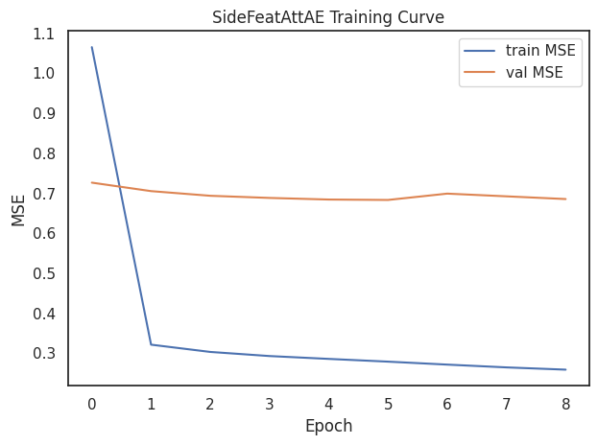
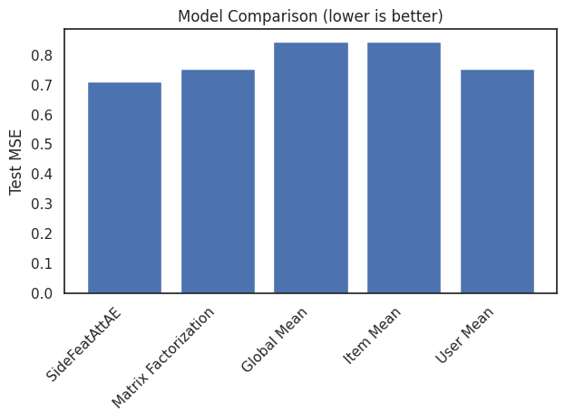
Test MSE
SideFeatAttAE: 0.712
Matrix Fact: 0.75337
Global Mean: 0.845
Item Mean: 0.845
User Mean: 0.75353

Slide 15
Recommendation System Task: SideFeat-AttAE
Model Improvements:
Text encoders: recipe name/steps or review text embeddings
User-side features: nutrition preference, cuisine preference, cooking preferences
More regularization: dropout, layernorm, learning rate schedules, better hyperparameter search
Beyond Rating Prediction
Use learned embeddings for top-N recommendation & recipe discovery (“you might also cook…”)
Incorporate dietary constraints and health/nutrition goals
Wider Impact
Same architecture can be applied to: movie/books/music recommendation, E-commerce products, etc.
Any domain where we have user-item interactions + rich item features + user preferences

Slide 16
NLP Task: Transformer Model (DeBERTa) & TF-IDF
Task & Data
Predict 1-5 star rating from review text (sentiment regression)
Use raw interaction data joined with train/val/test splits
Baselines: TF-IDF + Ridge
TF-IDF on reviews + Ridge regression to predict real-valued rating
Main Model - Transformer regression
Fine-tuned DaBERTa: review -> dense embedding -> scalar rating
Trained end-to-end with MSE loss on rating
Why Transformer > TF-IDF
TF-IDF: bag of words, no word order, linear weights on tokens
Transformer: model context + semantics, better understanding
Evaluation: MSE

Slide 17
NLP Task: Transformer (DeBERTa) vs TF-IDF
Results
Transformer MSE: 0.286
Tfidf + ridge MSE: 0.378

Slide 18
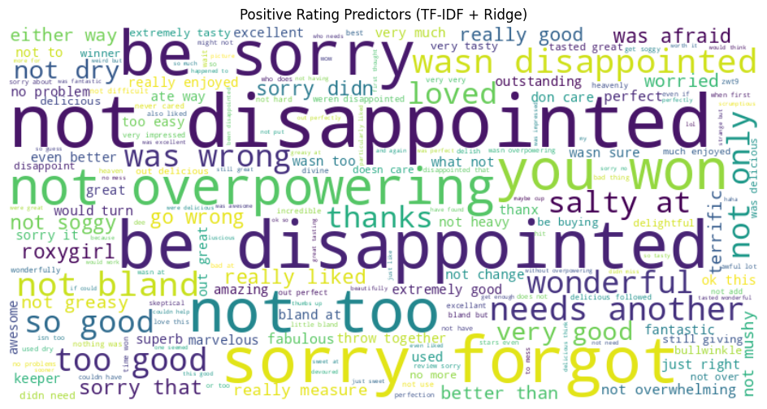
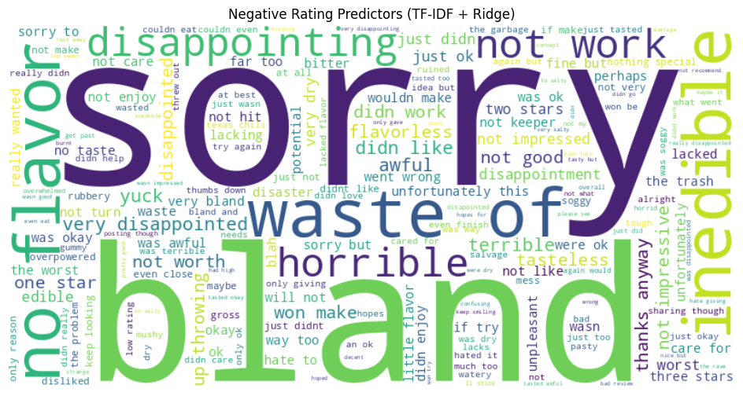
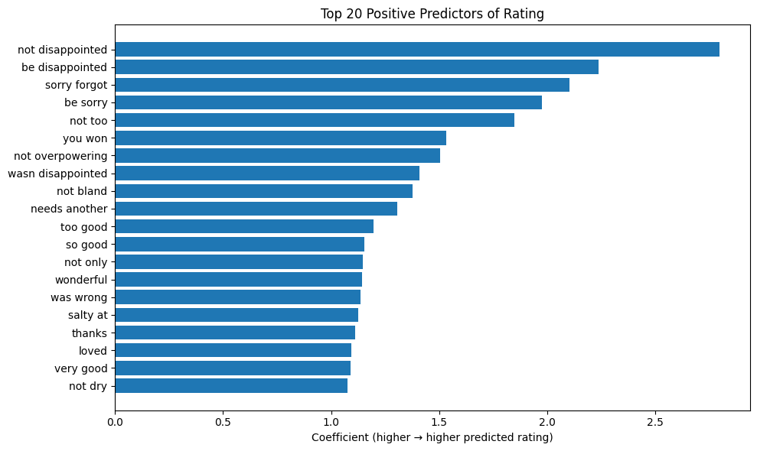
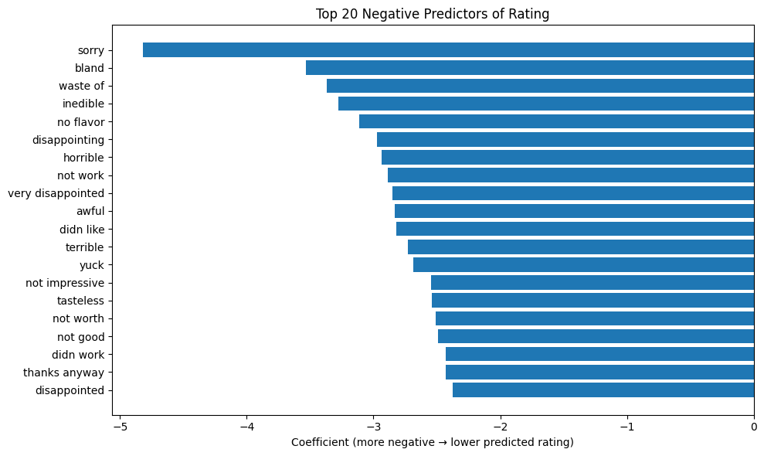
TF+IDF results

Slide 19
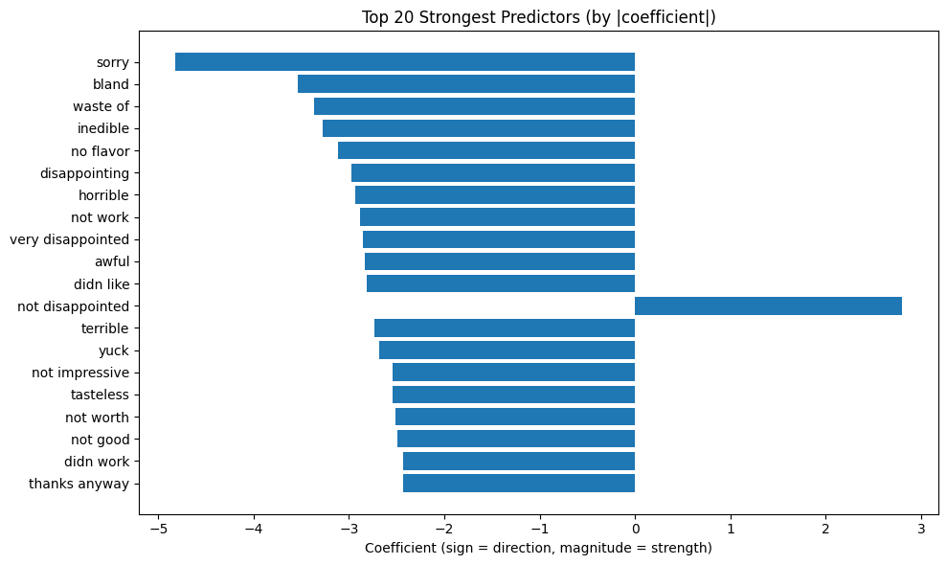
TF+IDF Results

Slide 21
Thank You!

